Slide 1
Retrieval Augmented Generation
Lecture 05 | July, 2026
Instructor: Sithvothy Kiv
Slides Credit: Josh Hug

Slide 2
Retrieval Augmented Generation
Retrieval Augmented Generation
What is RAG?
How RAG Works in Kestra
Example: Kestra Release Features
Step 1: Without RAG
Step 2: With RAG
Extending RAG with web search
Static RAG vs. web search RAG
Best Practices

Slide 3
Retrieval Augmented Generation
AI Copilot solves the context problem for flow generation. But what about workflows that need to answer questions from your own data? That's where RAG comes in.
‹#›

Slide 4
What is RAG?
Retrieval Augmented Generation
What is RAG?
How RAG Works in Kestra
Example: Kestra Release Features
Step 1: Without RAG
Step 2: With RAG
Extending RAG with web search
Static RAG vs. web search RAG
Best Practices

Slide 5
What is RAG?
01 / RETRIEVE
Data Retrieval
Query and extract highly relevant context from your external structured or unstructured data sources.
02 / AUGMENT
Prompt Context
Dynamically enrich the user query by appending the retrieved data context directly into the AI prompt.
03 / GENERATE
Grounded Output
Generate a precise response utilizing the LLM, guaranteed to be grounded in real-time, verified data.
Key Solution: Eliminating Hallucinations
RAG ensures the AI has access to current, accurate information at query time, preventing factual errors by basing responses strictly on your business data.
‹#›

Slide 6
How RAG Works in Kestra
Retrieval Augmented Generation
What is RAG?
How RAG Works in Kestra
Example: Kestra Release Features
Step 1: Without RAG
Step 2: With RAG
Extending RAG with web search
Static RAG vs. web search RAG
Best Practices

Slide 7
How RAG Works in Kestra
RAG has two phases. In the demo flows below they run back-to-back, but in production you'd typically schedule them separately — ingest on a cadence, query on demand.
01 / INGEST
Ingest Phase
Ingest on a cadence
Extract data from your sources, generate vector embeddings, and store them to build a highly optimized context library.
02 / QUERY
Query Phase
Query on demand
Retrieve relevant context instantly when a user asks a question, enriching the AI prompt to generate verified, hallucination-free answers.
‹#›

Slide 8
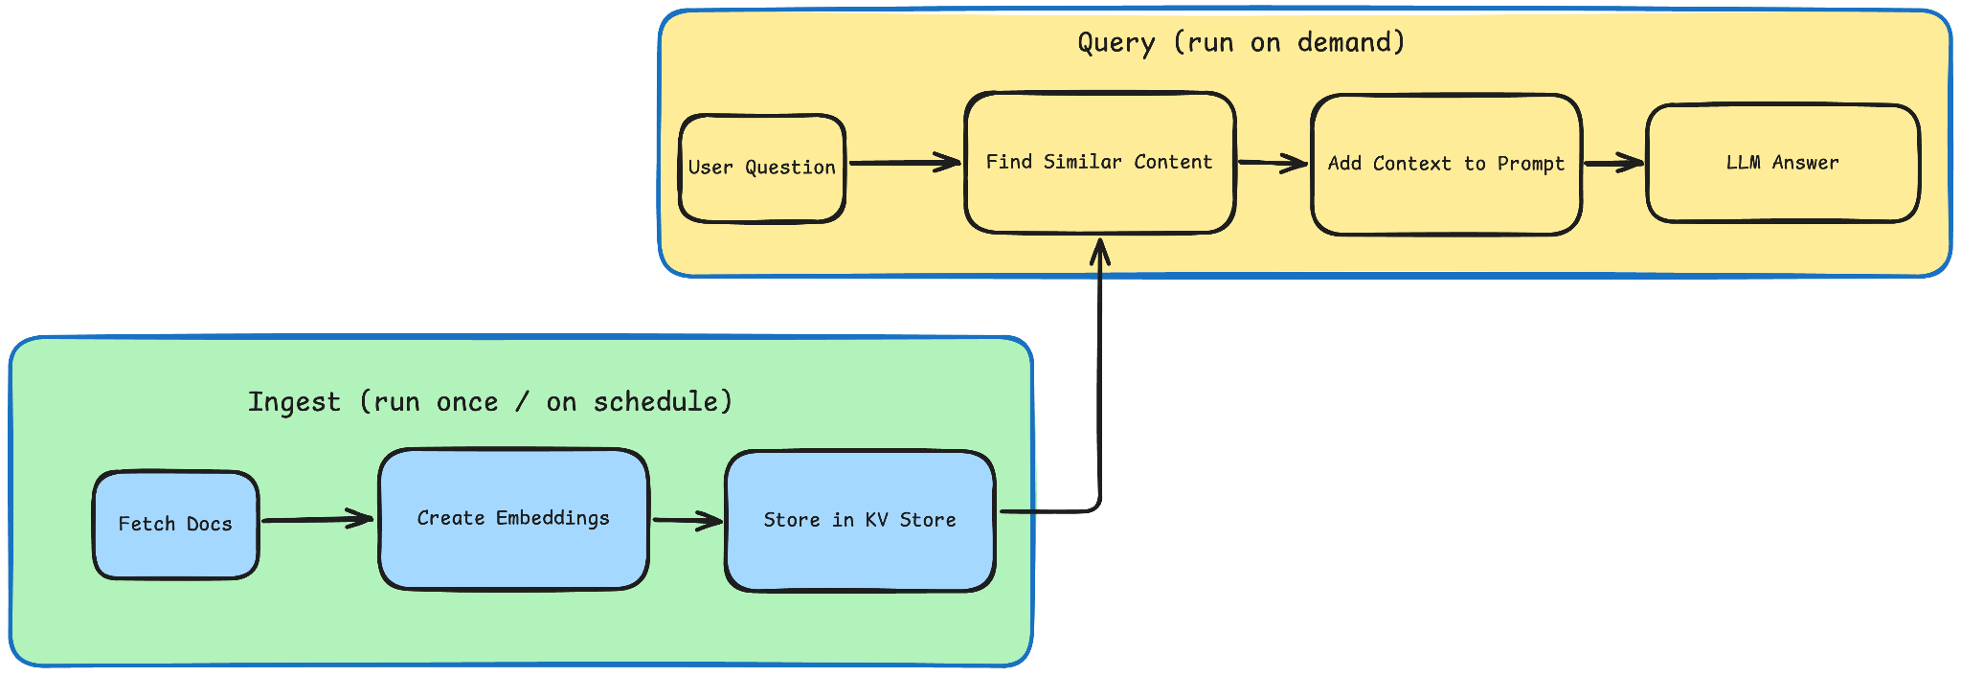
How RAG Works in Kestra
‹#›

Slide 9
How RAG Works in Kestra
Ingest phase (run once, or on a schedule when your data changes):
Fetch documents: load documentation, release notes, or other data sources
Create embeddings: convert text into vectors using an embedding model
Store embeddings: save vectors in Kestra's KV Store
Note: The flows store embeddings in Kestra's KV Store for simplicity. This is convenient for learning and small-scale demos, but it is not a replacement for a proper vector database. For any serious workload, e.g. larger document sets, low-latency retrieval, or production use, you should use a dedicated vector store.
‹#›

Slide 10
How RAG Works in Kestra
Query phase (runs every time a question is asked):
Retrieve context: find the embeddings most similar to the user's question
Augment the prompt: add the retrieved content to the LLM prompt
Generate response: the LLM answers using real, grounded context
‹#›

Slide 11
Example: Kestra Release Features
Retrieval Augmented Generation
What is RAG?
How RAG Works in Kestra
Example: Kestra Release Features
Step 1: Without RAG
Step 2: With RAG
Extending RAG with web search
Static RAG vs. web search RAG
Best Practices

Slide 12
Step 1: Without RAG
Retrieval Augmented Generation
What is RAG?
How RAG Works in Kestra
Example: Kestra Release Features
Step 1: Without RAG
Step 2: With RAG
Extending RAG with web search
Static RAG vs. web search RAG
Best Practices

Slide 13
Step 1: Without RAG
Flow: 1_chat_without_rag.yaml
This flow asks Gemini: "Which features were released in Kestra 1.1?"
Without RAG, the model might hallucinate features that don't exist, provide outdated information, or give vague generic answers.
Import and run this flow, then check the output — the response won't be accurate.
‹#›

Slide 14
Step 2: With RAG
Retrieval Augmented Generation
What is RAG?
How RAG Works in Kestra
Example: Kestra Release Features
Step 1: Without RAG
Step 2: With RAG
Extending RAG with web search
Static RAG vs. web search RAG
Best Practices

Slide 15
Step 2: With RAG
Flow: 2_chat_with_rag.yaml
This flow:
Ingests the Kestra 1.1 release blog post from GitHub
Creates embeddings using Gemini's embedding model
Stores embeddings in Kestra's KV Store
Asks the LLM the same question with RAG enabled
Returns an accurate response with real features from that release
Import and run 2_chat_with_rag.yaml and compare the output quality against the previous flow.
‹#›

Slide 16
Extending RAG with web search
Retrieval Augmented Generation
What is RAG?
How RAG Works in Kestra
Example: Kestra Release Features
Step 1: Without RAG
Step 2: With RAG
Extending RAG with web search
Static RAG vs. web search RAG
Best Practices

Slide 17
Extending RAG with web search
The examples above use static RAG — documents are ingested once and stored in the KV Store. Kestra also supports web search as a retriever, which fetches live results at query time and passes them as context to the LLM.
Flow: 3_rag_with_websearch.yaml
Visit Google AI Studio and sign in or create an account
Go to API keys and create a new key
Export it as a secret before starting Kestra: export SECRET_GEMINI_API_KEY=$(echo -n "your-api-key-here" | base64) docker compose up -d
Reference it in flows with {{ secret('GEMINI_API_KEY') }}
‹#›

Slide 18
Extending RAG with web search
The TavilyWebSearch retriever queries Tavily and injects the results as context before the LLM generates a response — no ingestion step required. However, the results are only as good as the search engine, and may not be relevant or accurate. Always test the quality of retrieved context when using web search RAG.
‹#›

Slide 19
Static RAG vs. web search RAG
Retrieval Augmented Generation
What is RAG?
How RAG Works in Kestra
Example: Kestra Release Features
Step 1: Without RAG
Step 2: With RAG
Extending RAG with web search
Static RAG vs. web search RAG
Best Practices

Slide 20
Static RAG vs. web search RAG
Criteria | Static RAG | Web Search RAG
Data source | Documents you ingested | Live web results
Best for | Internal docs, policies, fixed knowledge bases | Time-sensitive or frequently changing information
Ingestion step | Required | Not required
Example question | "What does our refund policy say?" | "What is the latest release of Kestra?"
Use static RAG when you control the source material. Use web search RAG when the answer depends on information that changes faster than you can re-ingest.
‹#›

Slide 21
Best Practices
Retrieval Augmented Generation
What is RAG?
How RAG Works in Kestra
Example: Kestra Release Features
Step 1: Without RAG
Step 2: With RAG
Extending RAG with web search
Static RAG vs. web search RAG
Best Practices

Slide 22
Best Practice
Keep documents updated: re-ingest regularly so your KV Store reflects current information
Chunk appropriately: break large documents into meaningful sections before ingesting
Test retrieval quality: verify the right documents are being retrieved for your queries
Choose the right retriever: static RAG for controlled knowledge bases, web search for live data
‹#›

